Slide 1
Eoin O’Dell
What is the Internet doing to me?
Tuesday 13 October 2020
Data Protection &
Covid 19
Subject access requests
Right to be forgotten
Notes:
<number>

Slide 2


Happy CyberSecurity Awareness Month
; image: https://cybersecuritymonth.eu/

Slide 3

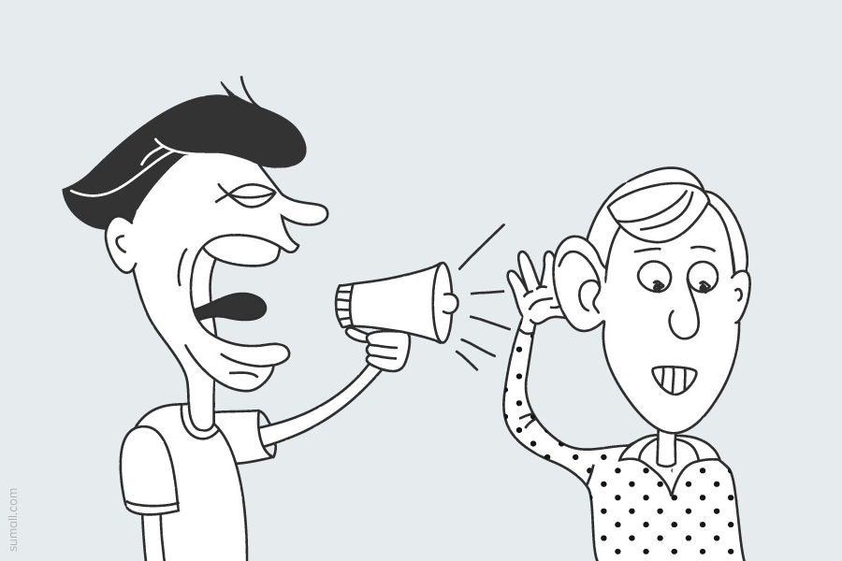
Hello
; image: https://www.flickr.com/photos/119023622@N04/13106270045/

Slide 4
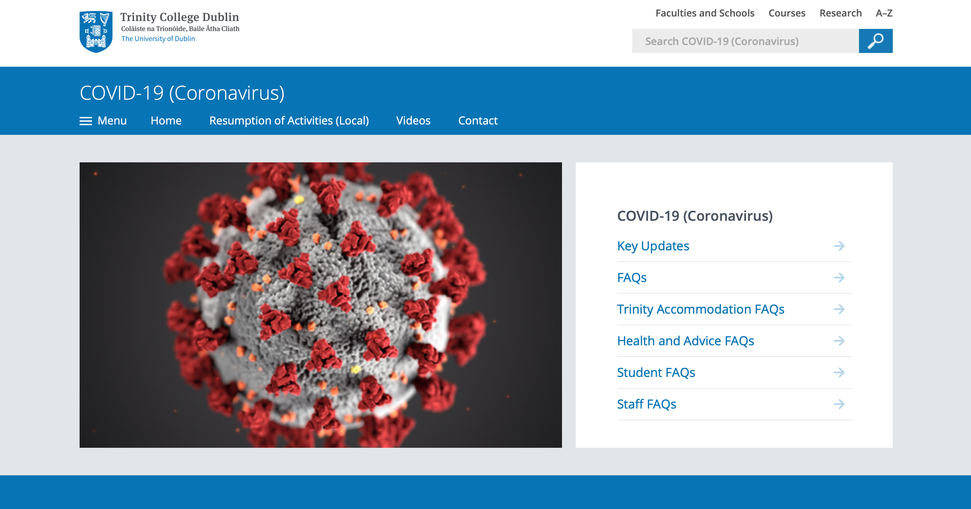
Covid-19 (Coronavirus)
; image: https://www.tcd.ie/about/coronavirus/

Slide 5

What are the privacy issues around Covid-19?
; image: https://pixabay.com/illustrations/quiz-question-game-test-answer-2004350/

Slide 6



What are the privacy issues around Covid-19?
; image: https://pixabay.com/illustrations/quiz-question-game-test-answer-2004350/

Slide 7

Tracker App
; image: https://covidtracker.gov.ie/

Slide 8
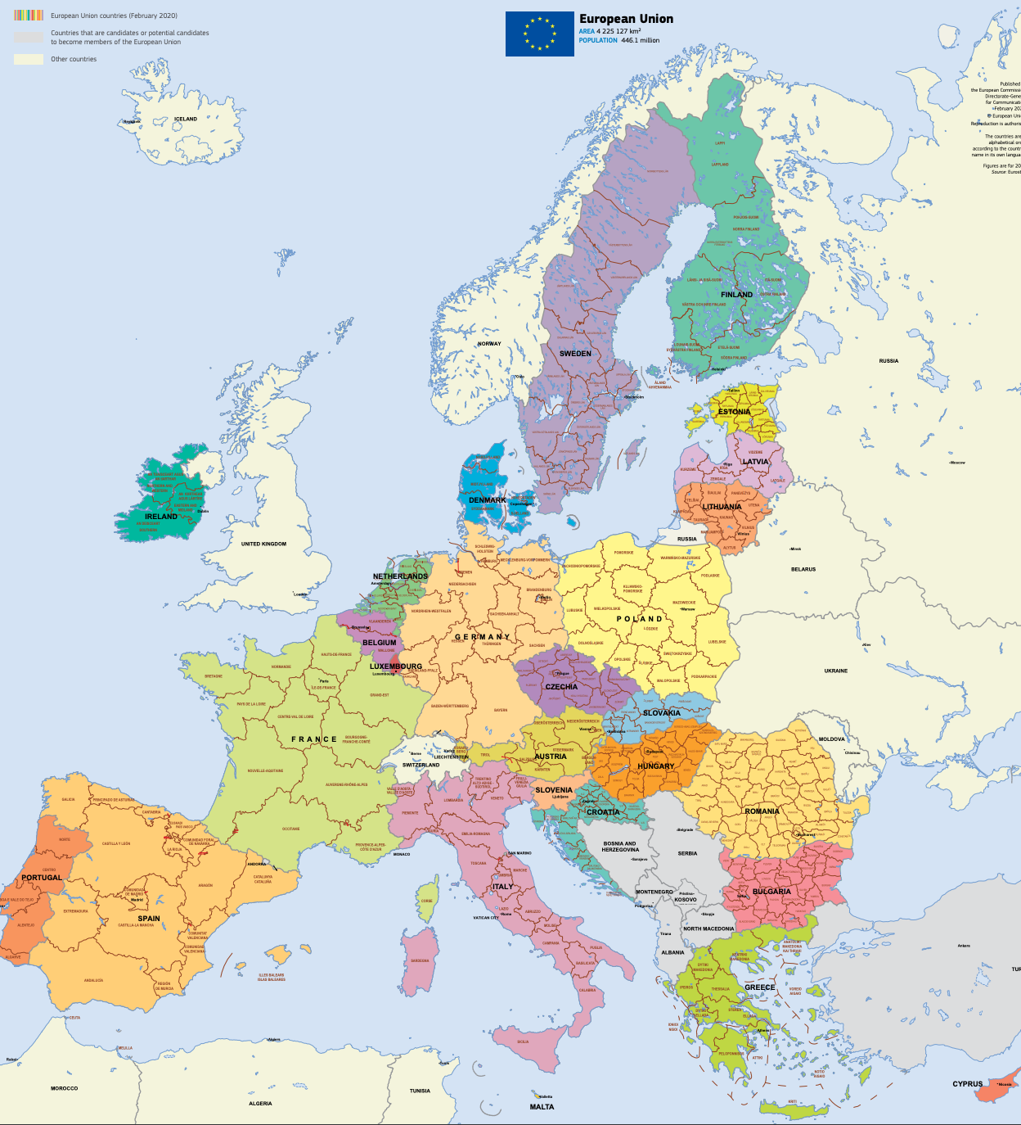
Health records
; image: via https://op.europa.eu/en/web/general-publications/maps

Slide 9
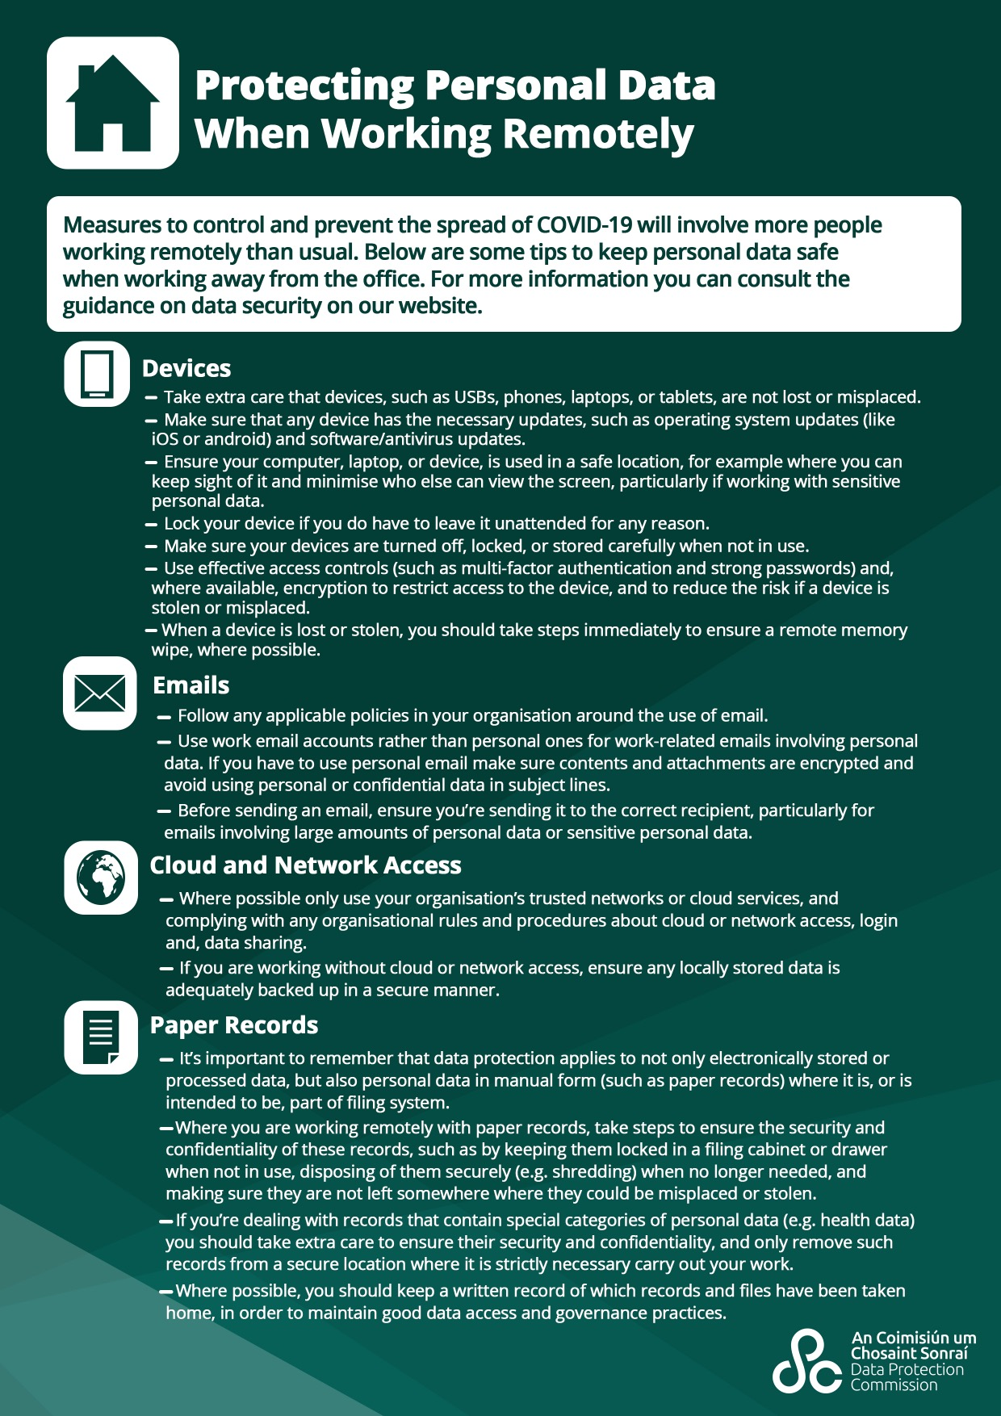
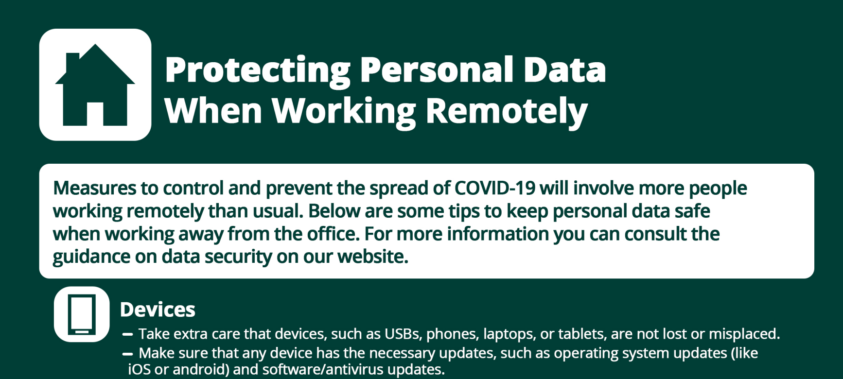
Working/studying from home
; image: https://www.dataprotection.ie/sites/default/files/uploads/2020-03/Guide%20for%20Individuals%20Working%20Remotely_0.pdf

Slide 10





Working/studying from home
jitsi
; images via wikipedia

Slide 11
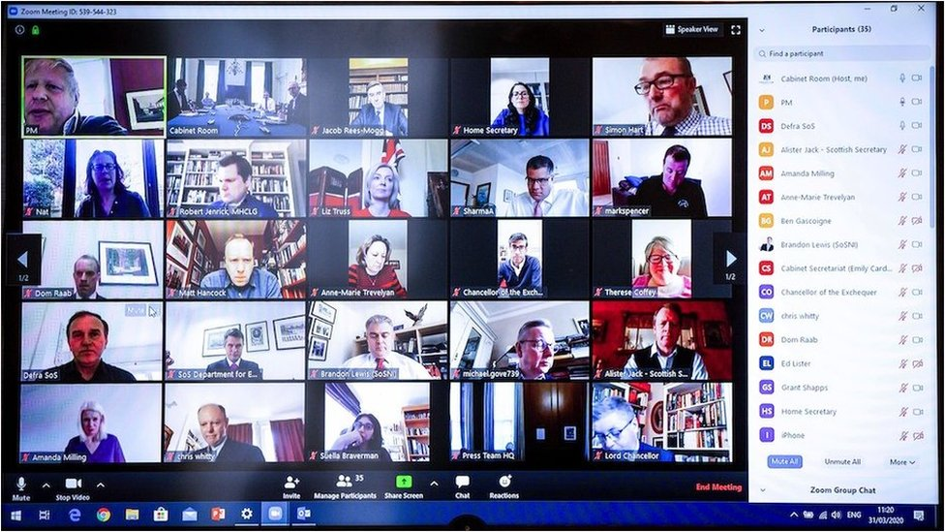
Working/studying from home
; image: https://www.bbc.com/news/technology-52126534

Slide 12

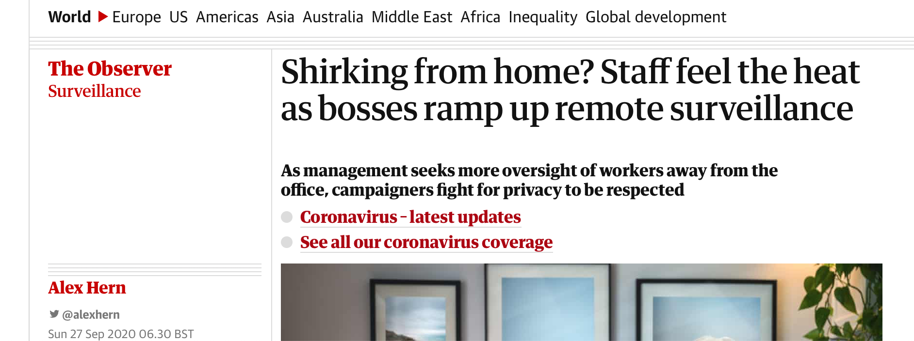
Working/studying from home
; image: https://www.dataprotection.ie/sites/default/files/uploads/2020-03/Guide%20for%20Individuals%20Working%20Remotely_0.pdf

Slide 13

Working/studying from home
; image: https://www.vice.com/en_us/article/n7wxvd/students-are-rebelling-against-eye-tracking-exam-surveillance-tools

Slide 14
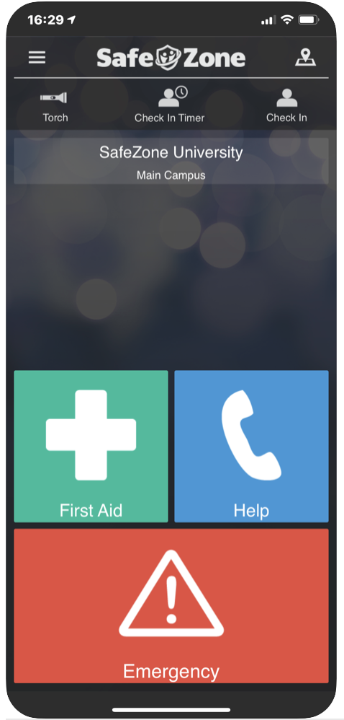
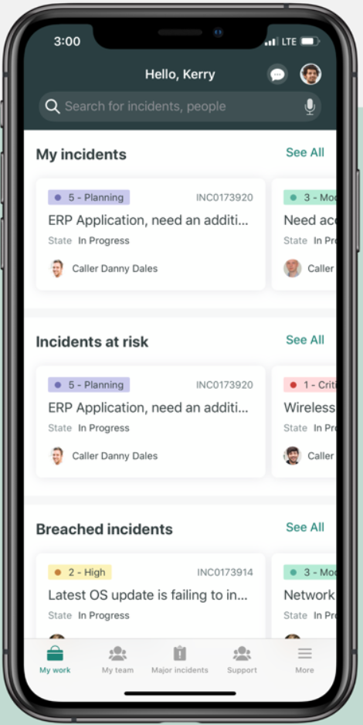
Return to work/college apps
; image: https://apps.apple.com/us/app/safezone/id533054756 & https://apps.apple.com/us/app/servicenow-agent/id1446951408

Slide 15

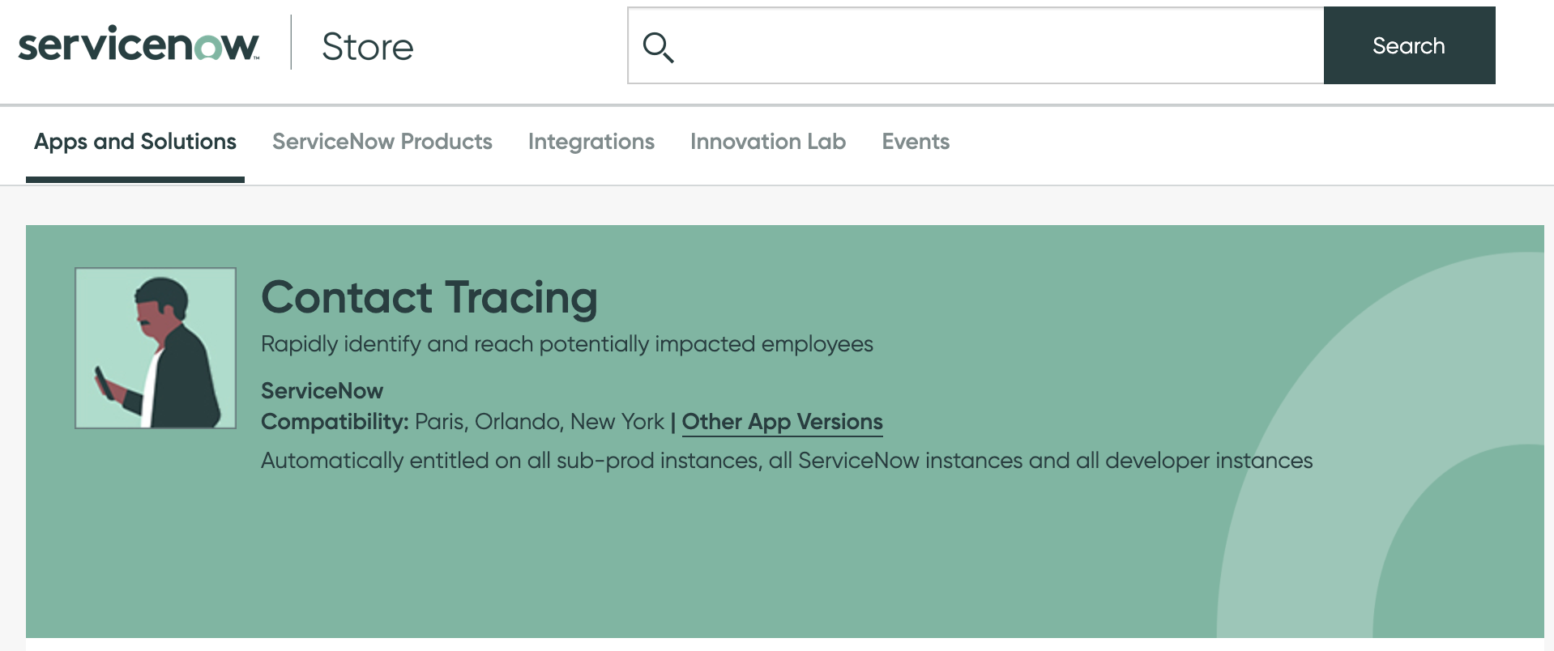
including private test/trace tracker apps
; image: https://www.rightcrowd.com/contact-tracing-solutions/?gclid=CjwKCAjw_Y_8BRBiEiwA5MCBJkEBQjoj_TboTAb68mRDSoQvipo5Unc1D5Rx5VWl6aShaBZVYduEfxoCl-UQAvD_BwE & https://store.servicenow.com/sn_appstore_store.do?campid=31519&cid=p:hr:dg:nb:rmkt:rtw_con_prsp:emea:all&s_kwcid=AL!11692!3!454628284269!b!!g!!%2Bcontact%20%2Btracing%20%2Bapp&ds_c=GOOG_EMEA_All_EN_CONVERSION_RTW_RLSA_Solution+Based_NonBrand_BMM&cmcid=71700000070667828&ds_ag=Contract+tracing_BMM&cmpid=58700006239682258&ds_kids=p56304946224&gclid=CjwKCAjw_Y_8BRBiEiwA5MCBJltYSaTBczHwf4mYFShoK0REGhoNtL-wv-godDHpOu-v_Bu3b8U6EhoCdDAQAvD_BwE&gclsrc=aw.ds#!/store/application/beda022c70991010f87781d40309fb19

Slide 16
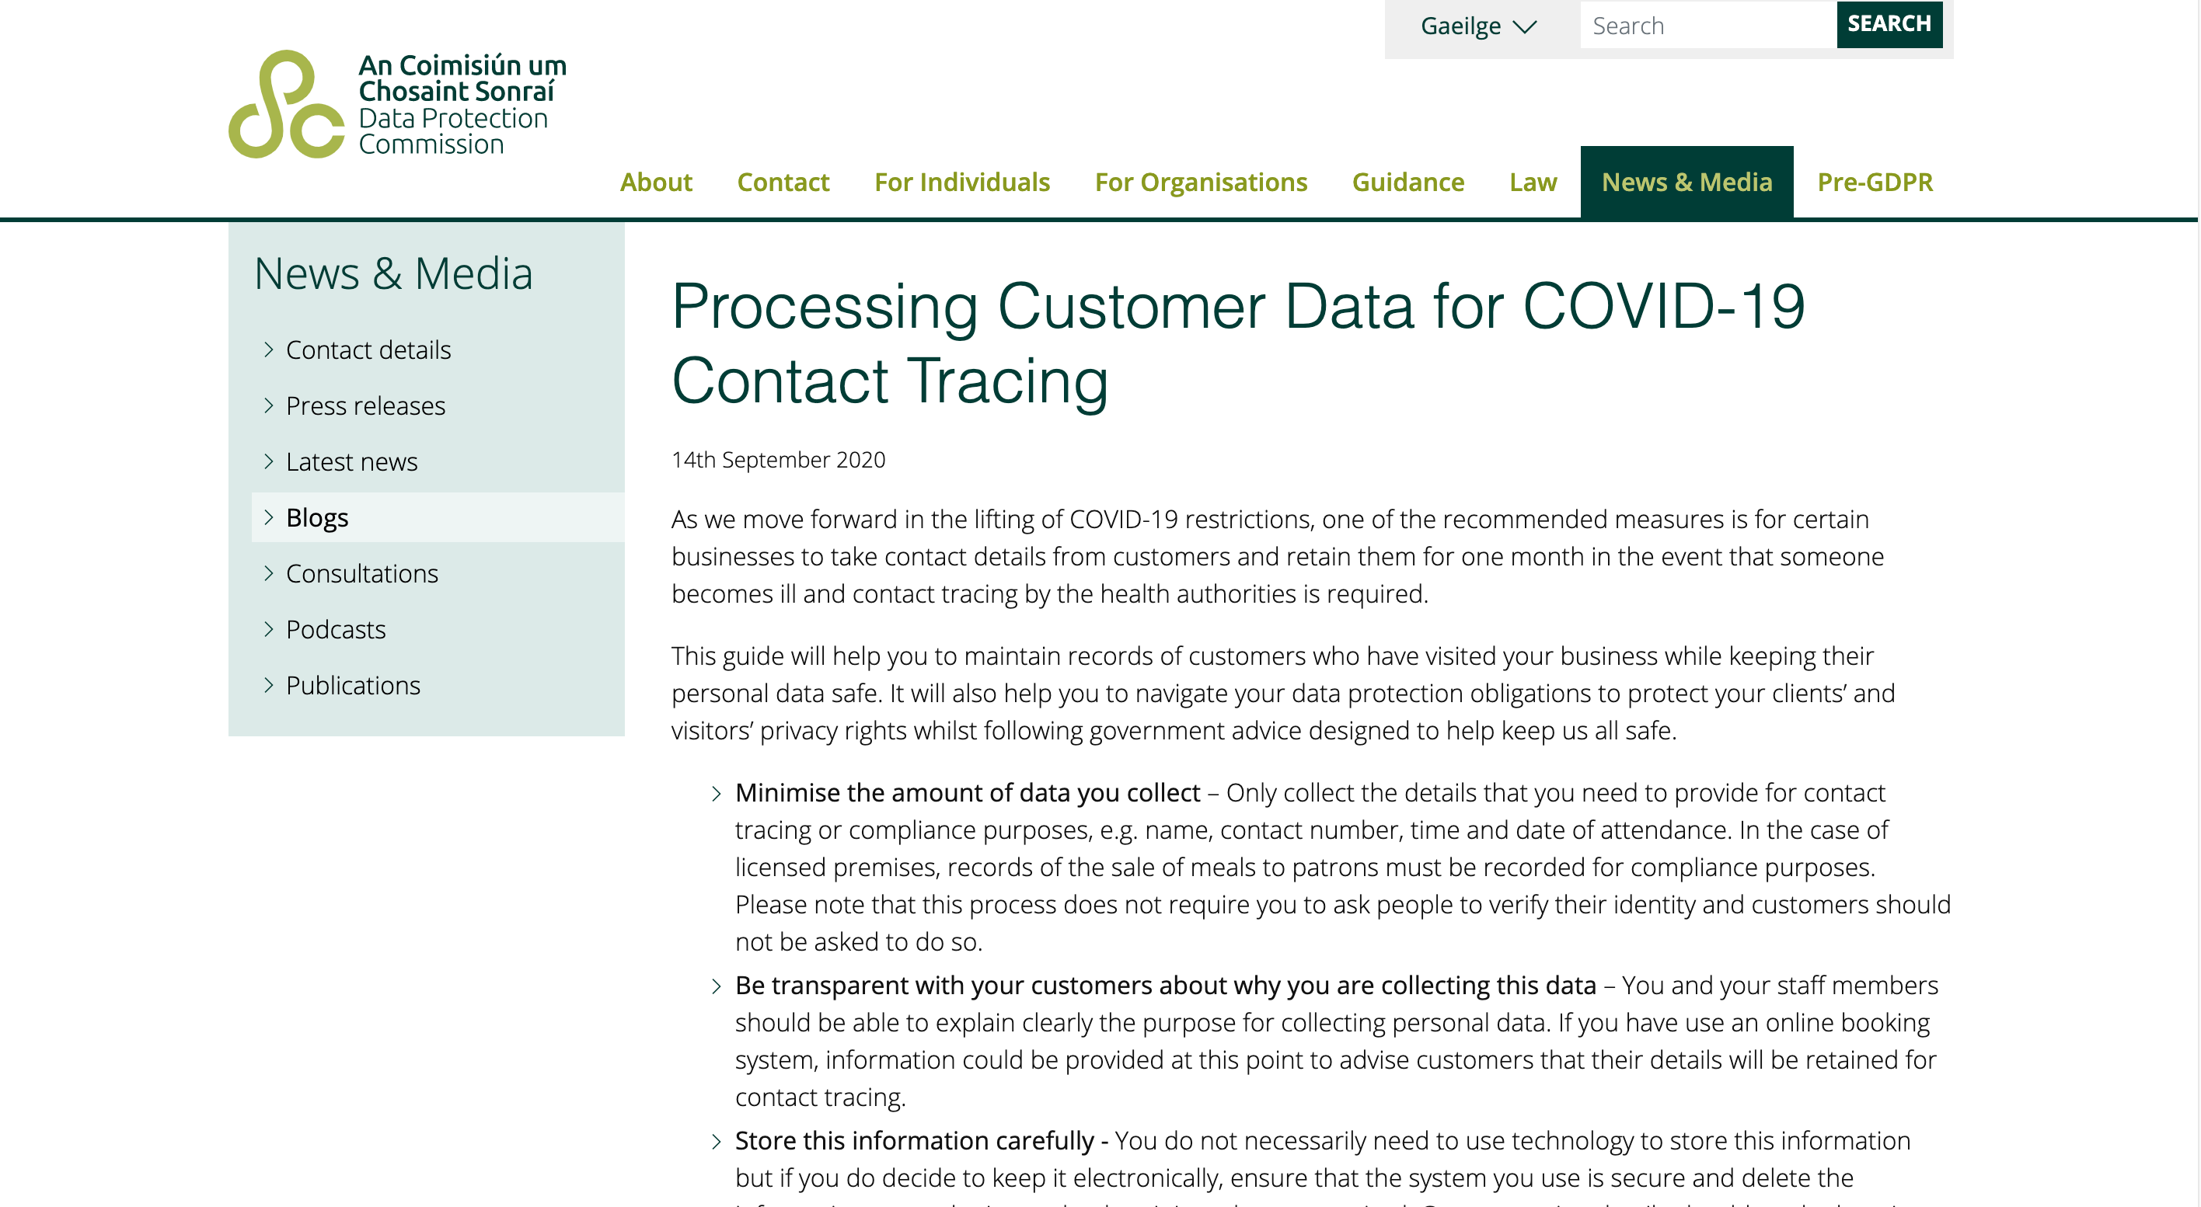
Test and trace contact data
Minimise the amount of data you collect
This process does not require you to ask people to verify their identity.
Be transparent with your customers about why you are collecting this data
Store this information carefully
Limit this data to the purpose for which it was collected
Ensure you delete contact details when you are no longer required to keep them for contact tracing or compliance purposes
; image: https://www.dataprotection.ie/en/news-media/blogs/processing-customer-data-covid-19-contact-tracing

Slide 17
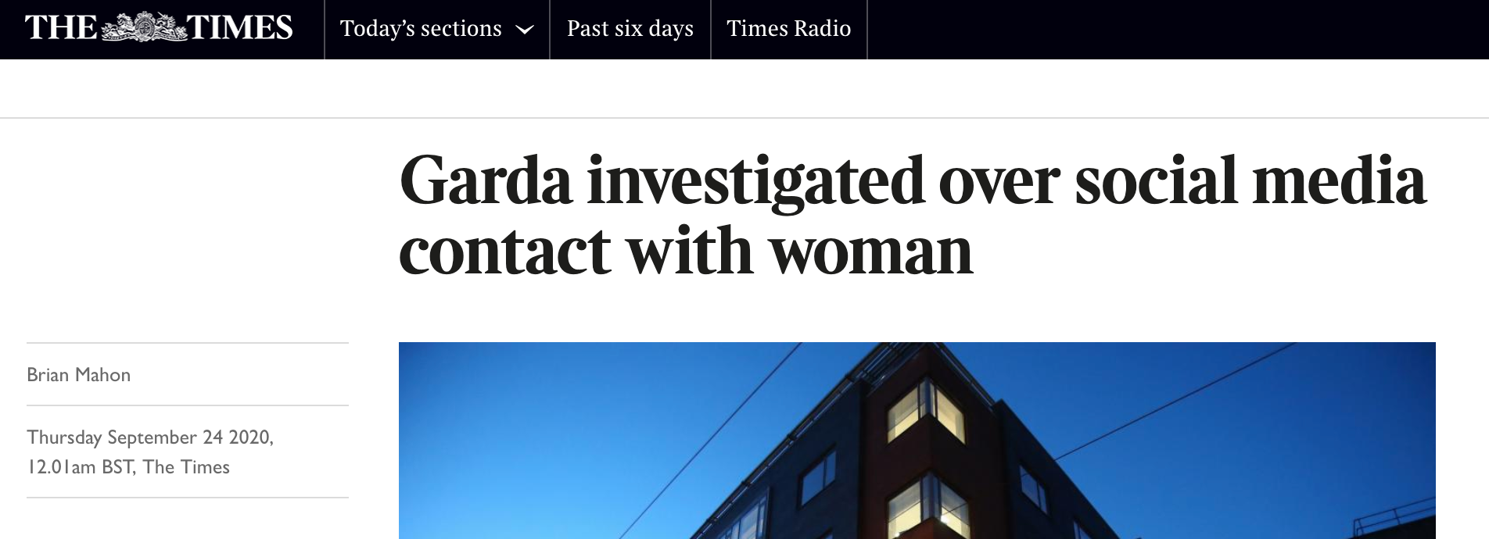
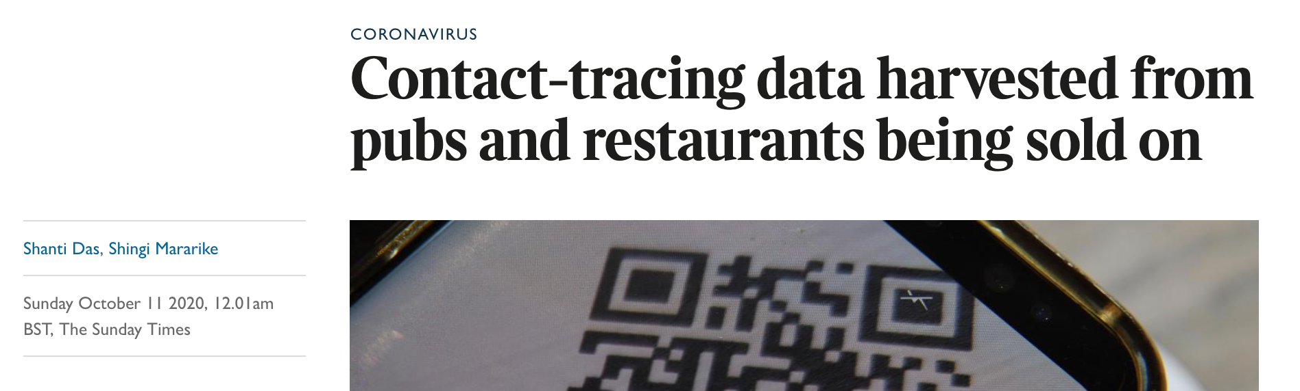
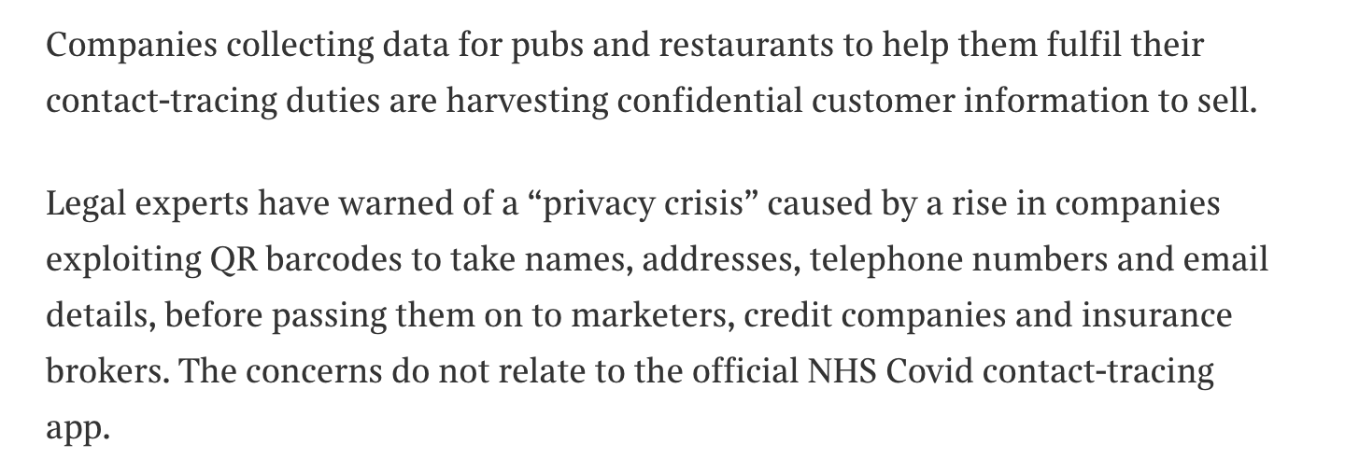

Test and trace contact data
; image: https://www.thetimes.co.uk/article/contact-tracing-data-harvested-from-pubs-and-restaurants-being-sold-on-s0d85mkrr

Slide 18
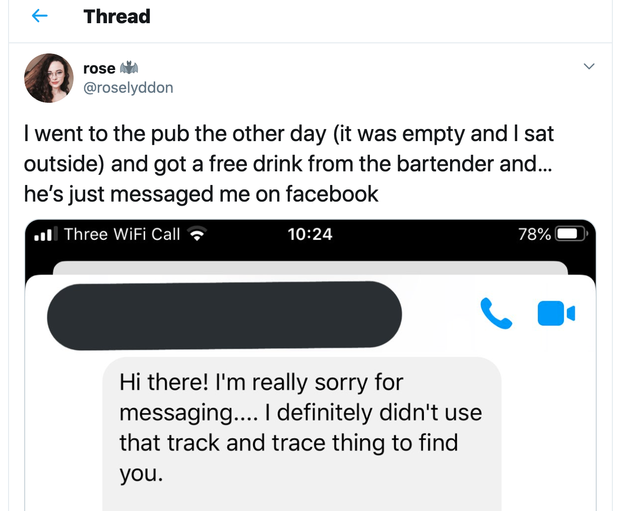
Test and trace contact data
; image: https://twitter.com/roselyddon/status/1281885086347075588

Slide 19
Test and trace data
; image: https://twitter.com/roselyddon/status/1281885086347075588

Slide 20







Snooping, outing, coronasnitching
XXXXXXXX
; image: https://www.reuters.com/article/uk-health-coronavirus-britain-masks-idUKKCN26G1TY
& https://www.mirror.co.uk/news/uk-news/police-turn-up-girls-birthday-22755946
& https://www.irishcentral.com/news/ireland-coronavirus-dublin-hospital
& https://economictimes.indiatimes.com/news/international/world-news/wuhan-shrimp-seller-identified-as-coronavirus-patient-zero/articleshow/74870327.cms

Slide 21

Recap
; image: https://commons.wikimedia.org/wiki/File:Gdpr_Europe.jpg

Slide 22
Recap
Personal data of data subjects
Data subject rights
; image: https://commons.wikimedia.org/wiki/File:Gdpr_Europe.jpg

Slide 23
Recap
Personal data of data subjects
Data subject rights
Principles of
processing
Obligations
of controller
; image: https://commons.wikimedia.org/wiki/File:Gdpr_Europe.jpg

Slide 24
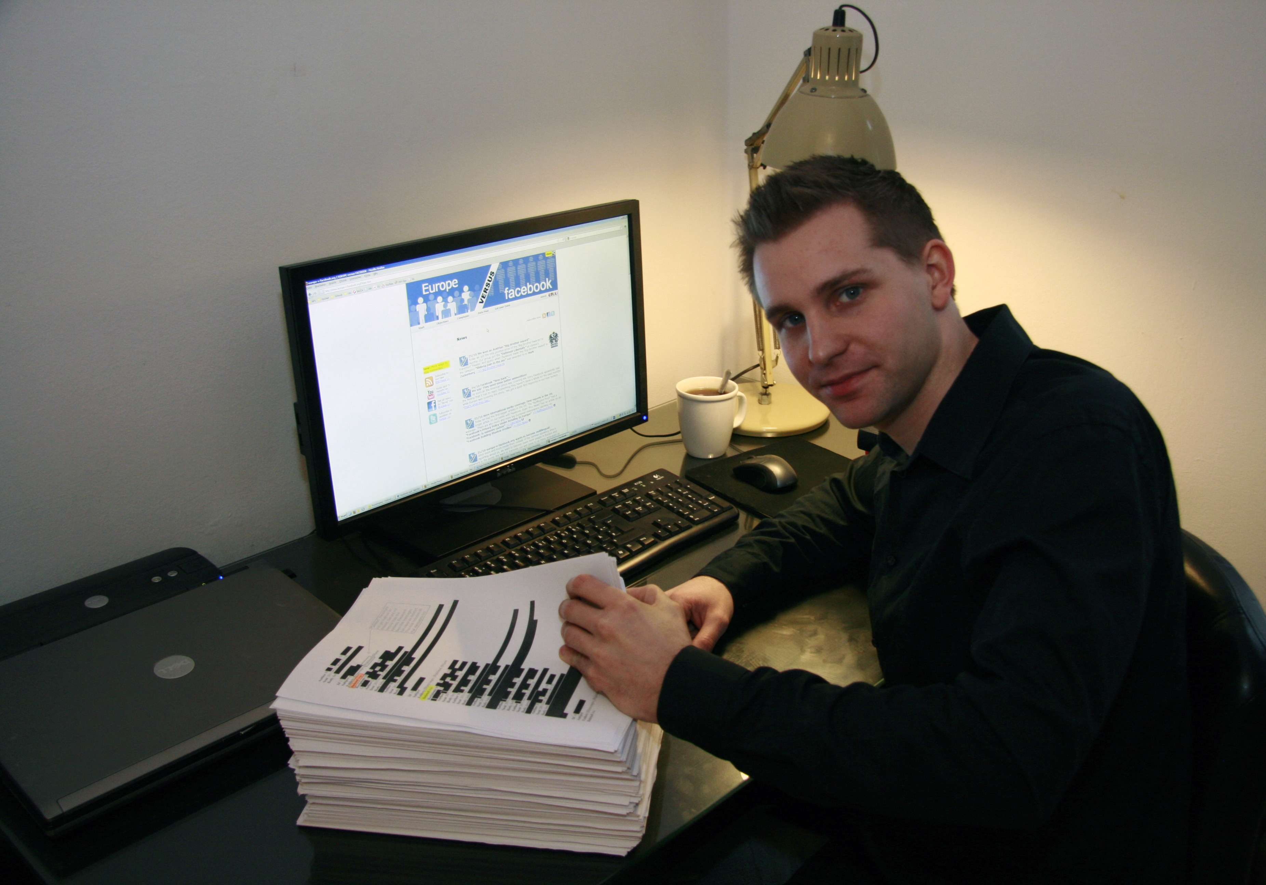
Who is this?
; image:
via http://europe-v-facebook.org/EN/Media/media.html

Slide 25
How does (eg) Facebook get data about you?
; image: https://pixabay.com/illustrations/quiz-question-game-test-answer-2004350/

Slide 26

Article 15 GDPR
Right of access by the data subject
(1) The data subject shall have the right to obtain from the controller
; text: https://eur-lex.europa.eu/eli/reg/2016/679/oj &
https://iapp.org/resources/article/the-eu-general-data-protection-regulation/#A15

Slide 27
Article 15 GDPR
Right of access by the data subject
(1) The data subject shall have the right to obtain from the controller
confirmation as to whether or not personal data concerning him or her are being processed,

Slide 28
Article 15 GDPR
Right of access by the data subject
(1) The data subject shall have the right to obtain from the controller
confirmation as to whether or not personal data concerning him or her are being processed, and,
where that is the case, access to the
[data subject’s] personal data

Slide 29
Article 15 GDPR
Right of access by the data subject
(1) The data subject shall have the right to obtain from the controller
confirmation as to whether or not personal data concerning him or her are being processed, and,
where that is the case, access to the
[data subject’s] personal data[,] and
the following information:

Slide 30
Article 15 GDPR
Right of access by the data subject
(a) purposes of processing;
(b) categories of personal data;
(c) recipients of the data;
(d) period of storage; …
(g) information as to the source of the data;
(h) the existence of automated
decision-making, including
profiling

Slide 31
Article 15 GDPR
Right of access by the data subject
(1) The data subject shall have the right to obtain from the controller … the following information:
(e) the existence of the right to request from the controller rectification or erasure of personal data or restriction of
processing … or to object;
(f) the right to lodge a complaint.

Slide 32
Article 15 GDPR
Right of access by the data subject
(3) The controller shall provide a copy of the personal data undergoing processing.

Slide 33
Article 15 GDPR
Right of access by the data subject
(3) The controller shall provide a copy of the personal data undergoing processing. ... Where the data subject makes the request by electronic means, and unless otherwise requested by the data subject, the information shall be provided in a commonly used electronic form.

Slide 34
Section 91 Data Protection Act 2018
Right of access
(1) [sets out Article 17 GDPR]
(2) Respond ASAP, within one month;
(5)&(6) In complex cases, may add up to
two more months
; text: http://www.irishstatutebook.ie/eli/2018/act/7/section/91/enacted/en/html#sec91

Slide 35
Section 91 Data Protection Act 2018
Right of access
(3) … the individual making the request shall provide the controller with such information as the controller may reasonably require to satisfy itself of the identity of the individual and to locate any relevant personal data or
information.

Slide 36

Who is this?
; image: https://www.flickr.com/photos/onionskn/7986185415/

Slide 37
How to make a data subject access request
Adam Ant
Stand and Deliver
; image: https://www.flickr.com/photos/onionskn/7986185415/

Slide 38


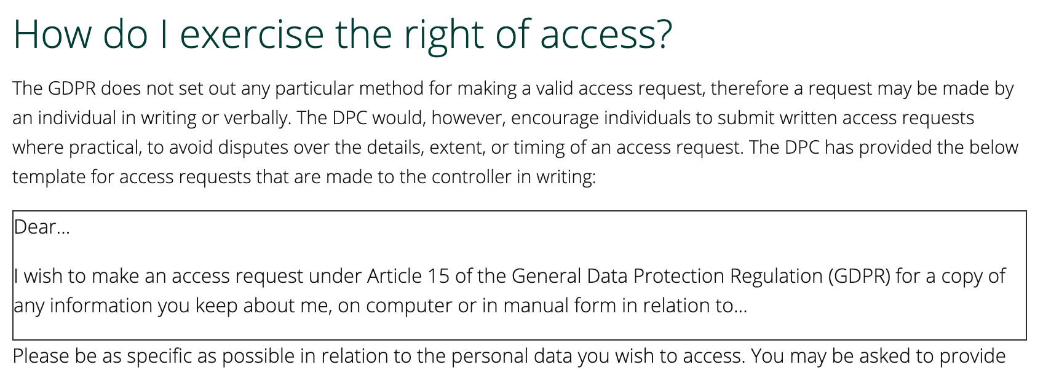

How to make a data subject access request
; image: https://www.dataprotection.ie/en/individuals/know-your-rights/right-access-information

Slide 39
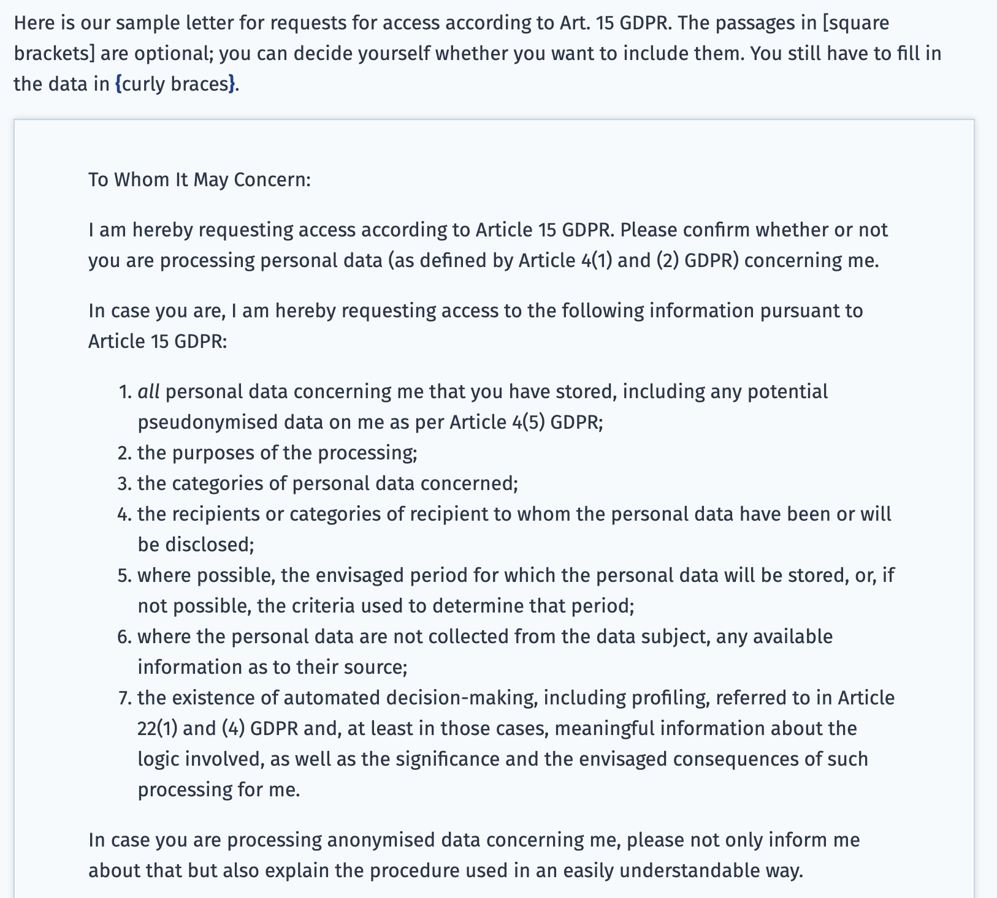
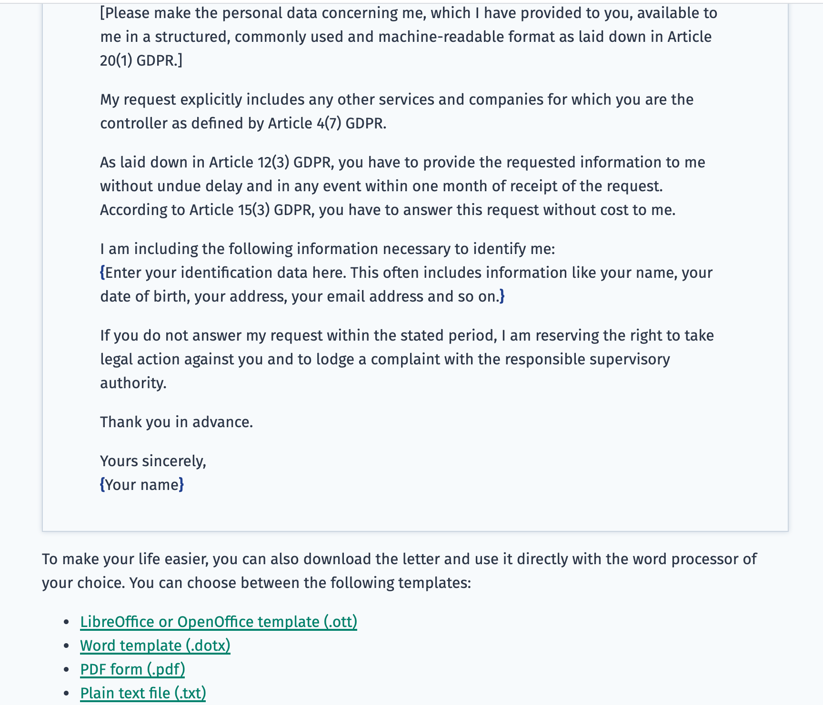
How to make a data subject access request
; image: https://www.datarequests.org/blog/sample-letter-gdpr-access-request/

Slide 40
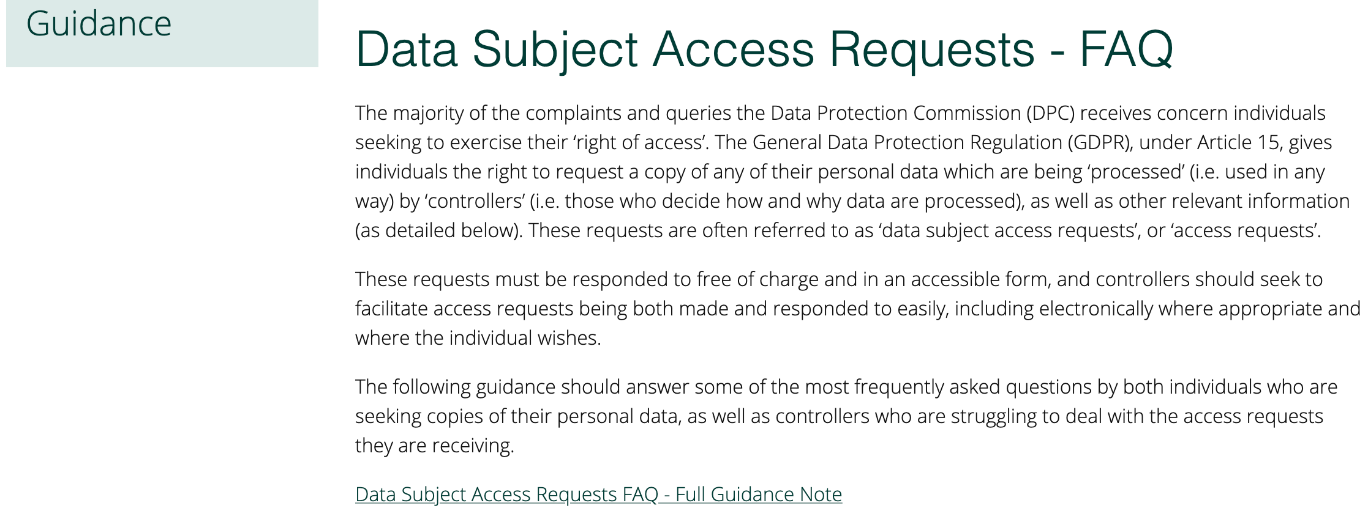
How to make a data subject access request
; image: https://www.dataprotection.ie/en/guidance-landing/data-subject-access-requests-faq

Slide 41
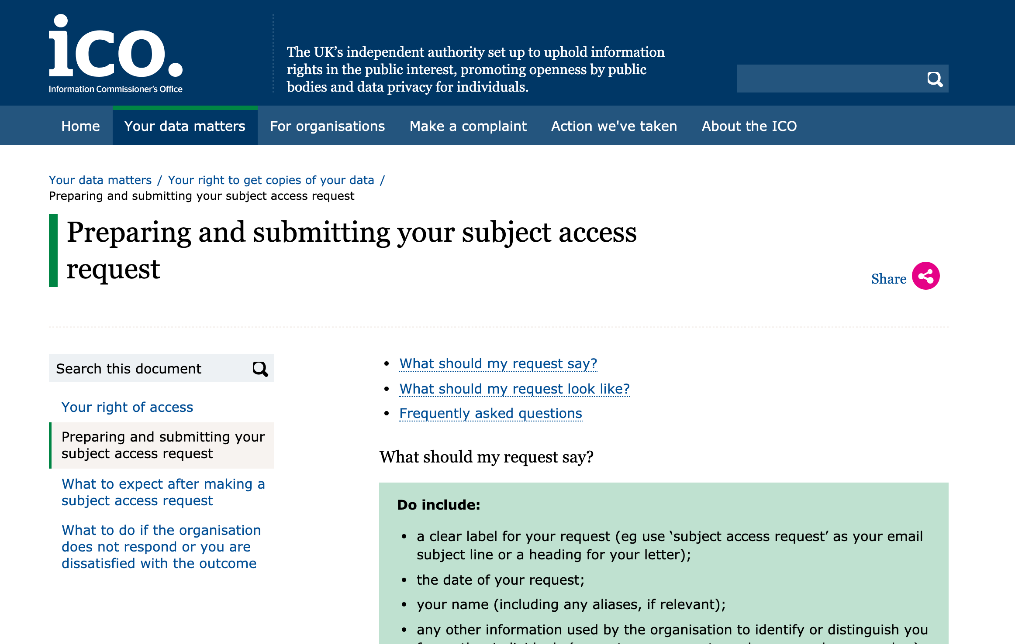
How to make a data subject access request
; image: https://ico.org.uk/your-data-matters/your-right-to-get-copies-of-your-data/preparing-and-submitting-your-subject-access-request/

Slide 42
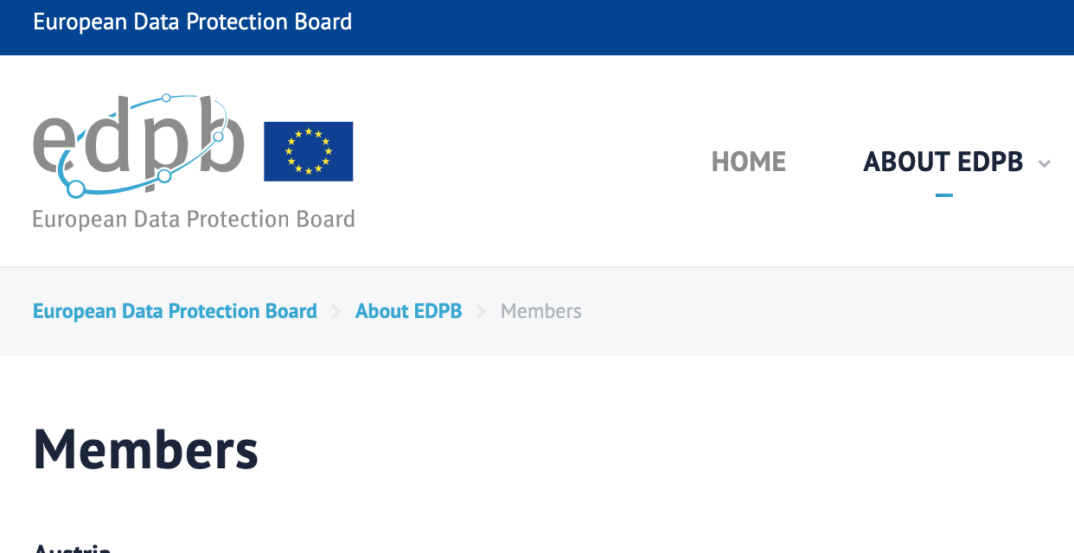

Other DPAs
; image: https://edpb.europa.eu/about-edpb/board/members_en &
via https://op.europa.eu/en/web/general-publications/maps

Slide 43

Who is this?
; image:

Slide 44
So, who do you want to SAR today?
; image: https://commons.wikimedia.org/wiki/File:Edwin_van_der_Sar_Web_Summit.jpg

Slide 45

Facebook
; image: http://europe-v-facebook.org/EN/Get_your_Data_/get_your_data_.html

Slide 46
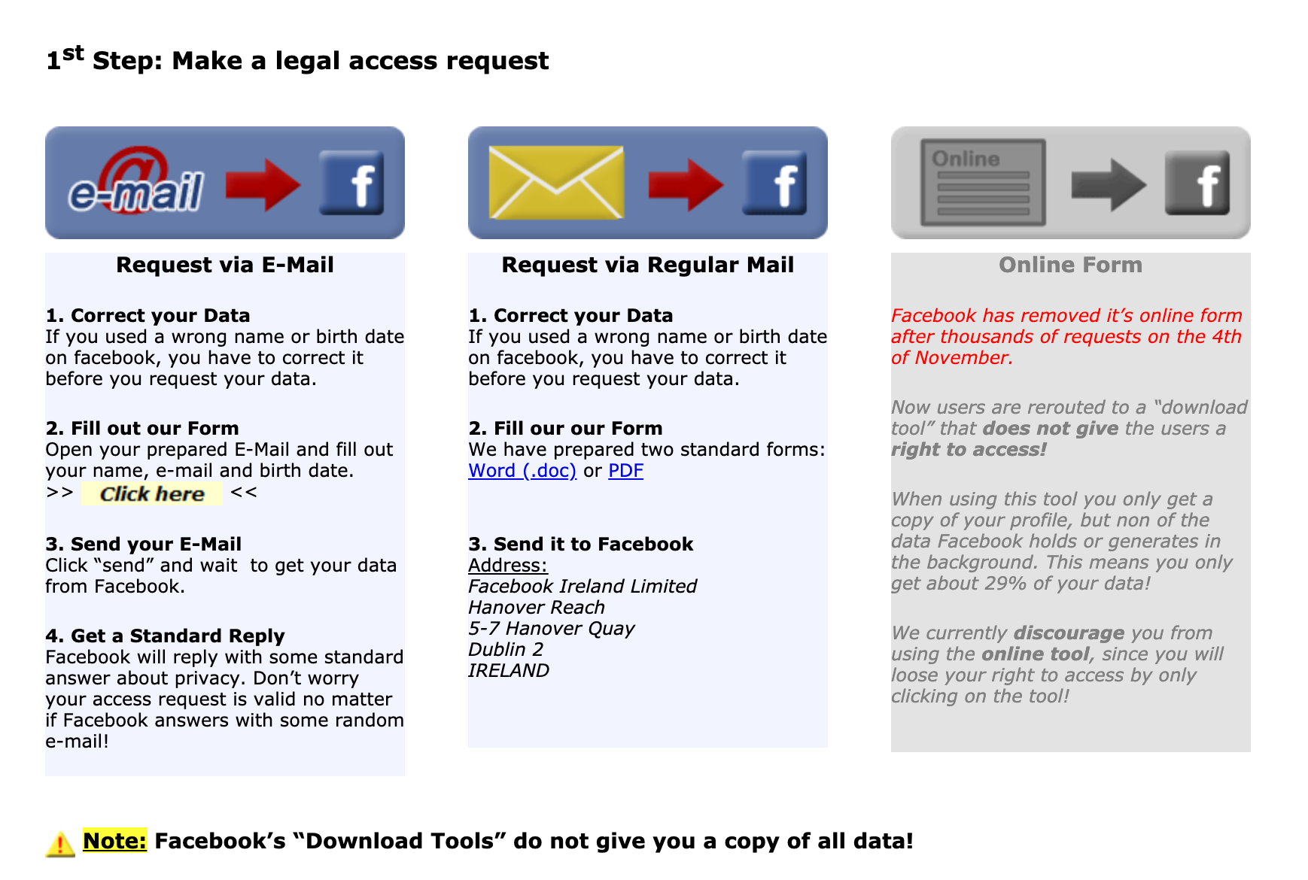
Facebook
; image: http://europe-v-facebook.org/EN/Get_your_Data_/get_your_data_.html

Slide 47
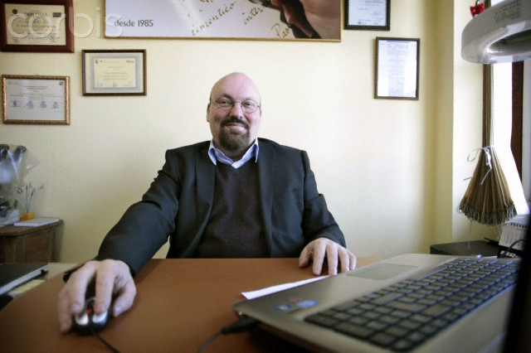
Who is this?
; image used by kind permission of the photographer, Jose Cabalar

Slide 48
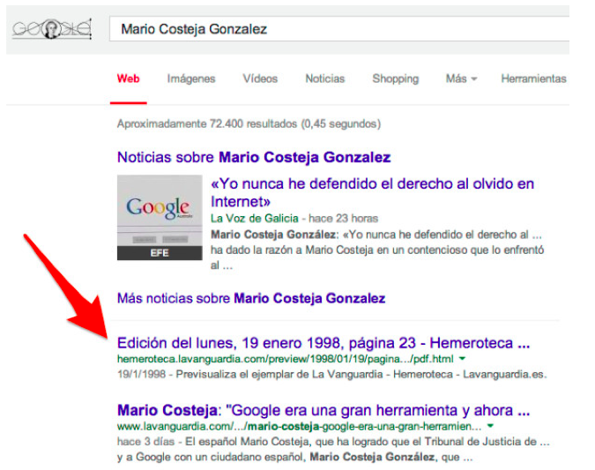

The search that started it all
; image http://searchengineland.com/figz/wp-content/seloads/2014/05/Mario_Costeja_Gonzalez_-_Buscar_con_Google-600x900.jpg

Slide 49
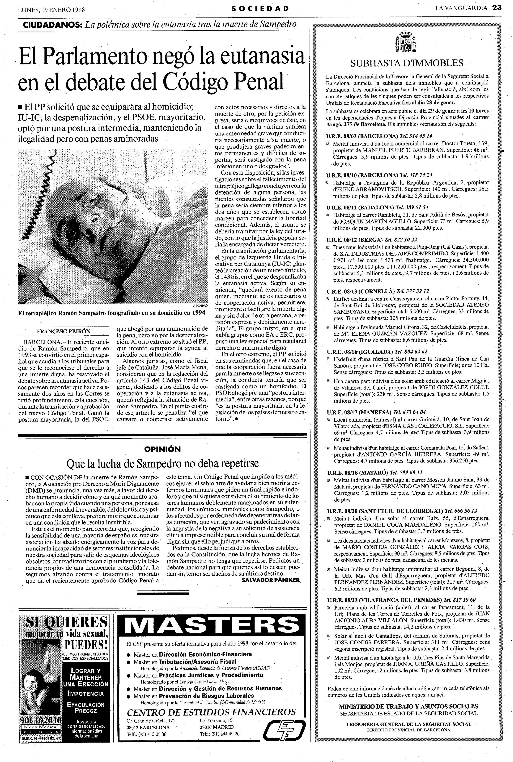
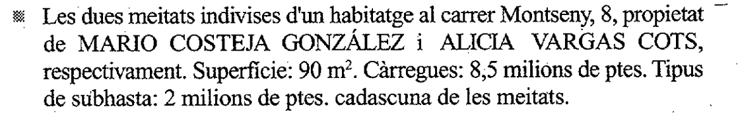
The search that started it all
The two halves of an undivided dwelling, 8 Montseny Street, property of MARIO COSTEJA GONZÁLEZ and ALICIA VARGAS COTS, respectively. Area: 90 m². Debt: 50,000 euro. Type of auction: 12,000 euro for each of the halves.
; image: http://hemeroteca.lavanguardia.com/preview/1998/01/19/pagina-23/33842001/pdf.html

Slide 50
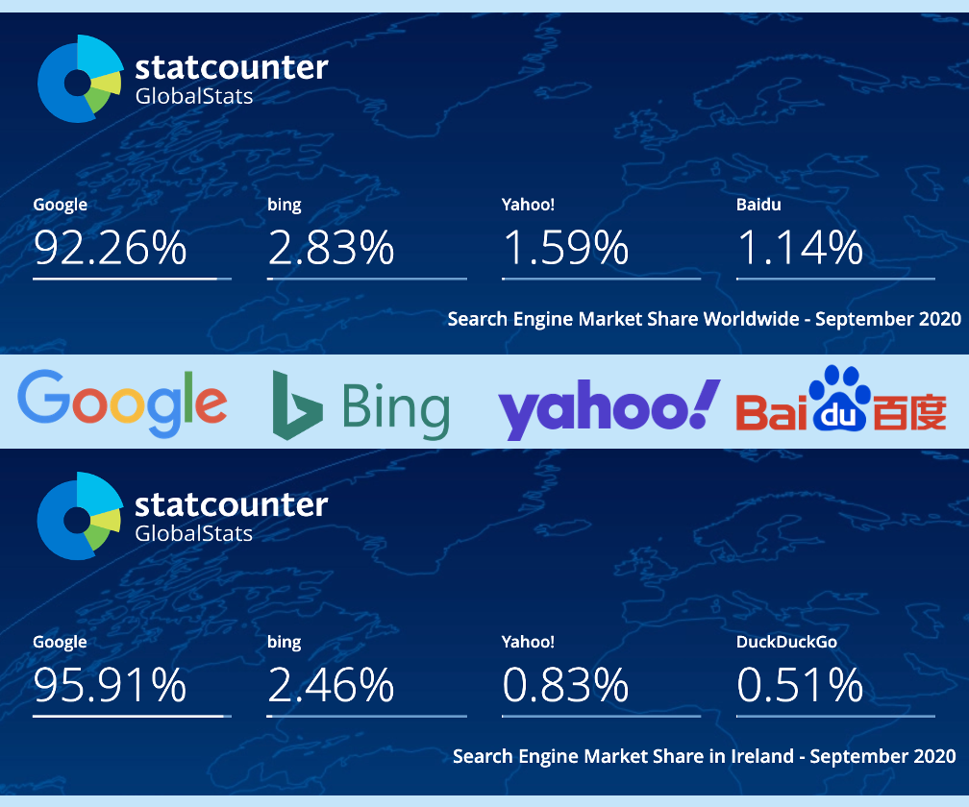
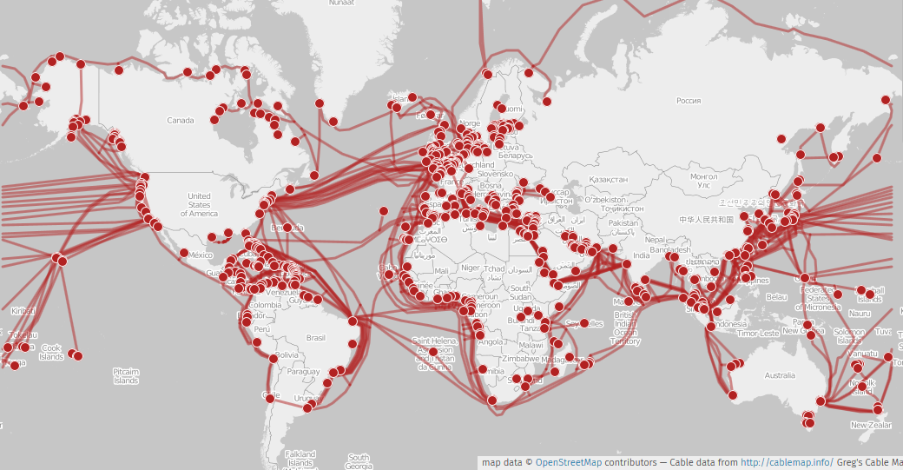




C‑131/12 Google Spain v AEPD and González
(CJEU, 13 May 2014; ECLI:EU:C:2014:317)
; image: https://gs.statcounter.com/search-engine-market-share/

Slide 51
C‑131/12 Google Spain v AEPD and González
(CJEU, 13 May 2014; ECLI:EU:C:2014:317)
The operator of a search engine is obliged to remove from the list of results displayed, following a search made on the basis of a person’s name, links to web pages, published by third parties and containing information relating to that person that is inadequate, irrelevant or no longer relevant, or excessive in relation to the purposes of the processing.

Slide 52
Article 17 GDPR
Right to erasure (‘right to be forgotten’)
(1) The data subject shall have the right to obtain from the controller the erasure of personal data concerning him or her without undue delay

Slide 53
Article 17 GDPR
Right to erasure (‘right to be forgotten’)
(1) The data subject shall have the right to obtain from the controller the erasure of personal data concerning him or her without undue delay[,] and the controller shall have the obligation to erase personal data without undue delay

Slide 54
Article 17 GDPR
Right to erasure (‘right to be forgotten’)
(1) The data subject shall have the right to obtain from the controller the erasure of personal data concerning him or her without undue delay[,] and the controller shall have the obligation to erase personal data without undue delay[,] where
one of the following grounds
applies:

Slide 55
Article 17 GDPR
Right to erasure (‘right to be forgotten’)
no longer necessary
withdraws consent
objects
unlawful processing

Slide 56
Article 17 GDPR
Right to erasure (‘right to be forgotten’)
(3) Para (1) shall not apply to the extent that processing is necessary:
(a) freedom of expression …
(c) reasons of public interest in the area
of public health
(d) research

Slide 57


Article 17 GDPR
Right to erasure (‘right to be forgotten’)
Requests to delist content under European privacy law: Ireland
; images and stats via https://transparencyreport.google.com/

Slide 58
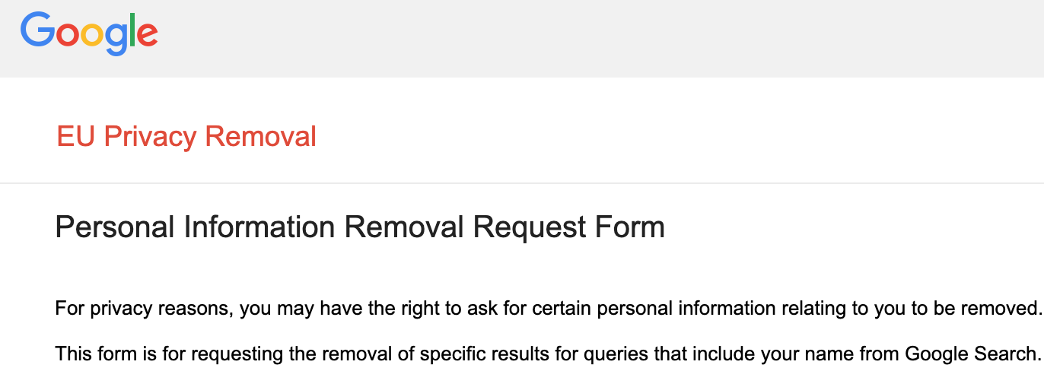
Article 17 GDPR
Right to erasure (‘right to be forgotten’)
; image: https://www.google.com/webmasters/tools/legal-removal-request?complaint_type=rtbf&visit_id=637202230061146146-20083139&rd=1

Slide 59

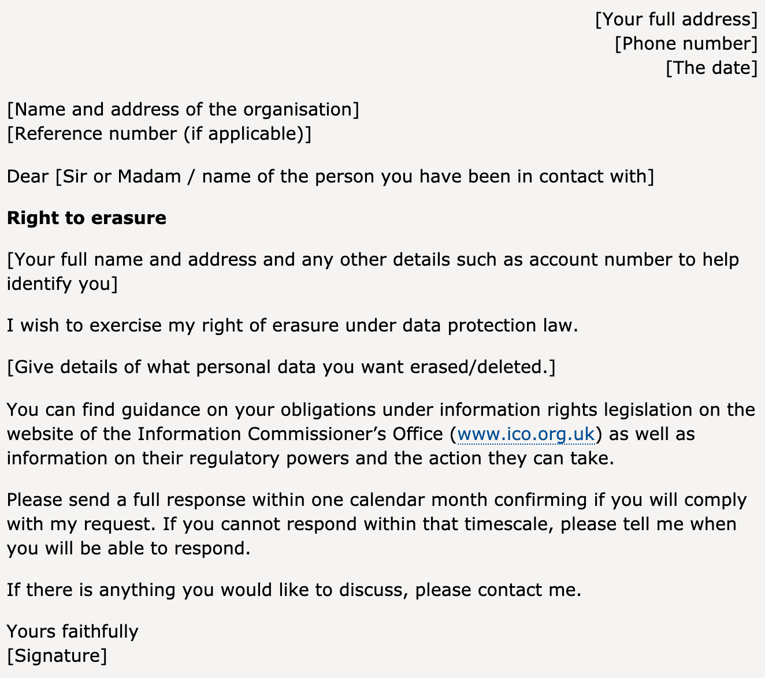
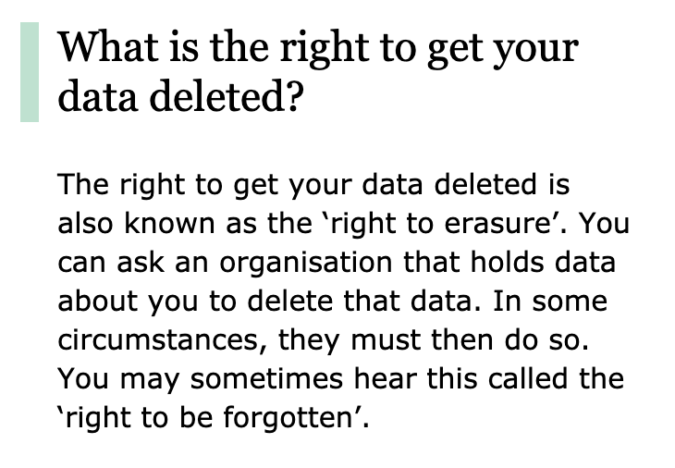
Article 17 GDPR
Right to erasure (‘right to be forgotten’)
; image: https://ico.org.uk/your-data-matters/your-right-to-get-your-data-deleted/

Slide 60
Article 17 GDPR
Right to erasure (‘right to be forgotten’)
; image: https://ico.org.uk/your-data-matters/your-right-to-get-your-data-deleted/

Slide 61

Article 17 GDPR
Right to erasure (‘right to be forgotten’)
Ego-surf (vanity search, ego-search, auto-google, self-google):
search for one’s own name on
a popular search engine.
; image: https://pixabay.com/illustrations/surfing-surf-cartoon-wood-water-4617672/

Slide 62


Any Questions?
; image http://maxpixel.freegreatpicture.com/static/photo/640/Empty-Old-Leave-Chalk-Board-School-
Blackboard-73496.png

Slide 63

; image https://www.freeimageslive.co.uk/free_stock_image/stay-safe-jpg

Slide 64
Thank You

